Slide 1
DEPARTMENT OF ELECTRICAL AND ELECTRONICS ENGINEERING
18EEP401L-MINOR PROJECT – IV
ZEROTH REVIEW
Borewell water overflow Detection and Prevention system
YEAR/ SEMESTER – III/VI
BATCH NUMBER :12
DATE :
PRESENTED BY: NALIN KUMAR S P (927622BEE073)
SANJAAI U N
(927622BEE094)
SHARMITHA S P
(927622BEE106)
GUIDED BY:
Mr. N Selvam M.E
Assistant Professor/EEE

Slide 2
PROBLEM STATEMENT
Autoflow wells in the Terai region rely on naturally pressurized aquifers to supply water without pumps. However, many private wells remain uncapped, leading to uncontrolled water discharge and wastage. Additionally, the constant flow makes it difficult to measure water levels, which is essential for groundwater monitoring and management. These challenges contribute to groundwater depletion and waterlogging in agricultural fields, affecting both water security and land productivity.

Slide 3
OBJECTIVE
Prevent continuous water loss by integrating a manually controlled tap to regulate outflow.
Monitor well conditions using an Arduino-based system with water level and pressure sensors.
Provide real-time data to help users make informed decisions for groundwater conservation.
Improve well management by enabling efficient water use and reducing the risk of over-extraction.
Support sustainable groundwater utilization by offering a cost-effective and adaptable solution.

Slide 4
ABSTRACT
Autoflow wells in the Terai region tap pressurized aquifers, allowing water to flow without pumps.
However, many private wells lack caps, causing continuous water loss. Measuring water levels is also challenging due to the constant flow.
This project develops a smart well cap with a tap to regulate water flow and an Arduino-based system using water level and pressure sensors for real-time monitoring.
This solution helps conserve groundwater and improves well management.

Slide 5
DESCRIPTION
Autoflow wells in the Terai region rely on naturally pressurized aquifers to supply water without the need for pumps.
While these wells provide a continuous and reliable water source, many private wells remain uncapped, leading to uncontrolled water discharge, wastage, and inefficient groundwater use.
To address these issues, this project proposes a smart well cap that integrates a manually controlled tap and an Arduino-based monitoring system. The tap allows users to regulate water flow, preventing unnecessary discharge and promoting efficient usage.

Slide 6
DESCRIPTION
The monitoring system consists of water level and pressure sensors, which continuously collect real-time data to track well conditions.
An Arduino microcontroller processes this data, which can be stored locally or transmitted remotely, depending on the available infrastructure.
By implementing this solution, well owners and authorities can reduce water wastage, improve monitoring, and make informed decisions for groundwater conservation.
It could play a significant role in preventing groundwater depletion, minimizing environmental impact, and ensuring long-term water resource sustainability.

Slide 7
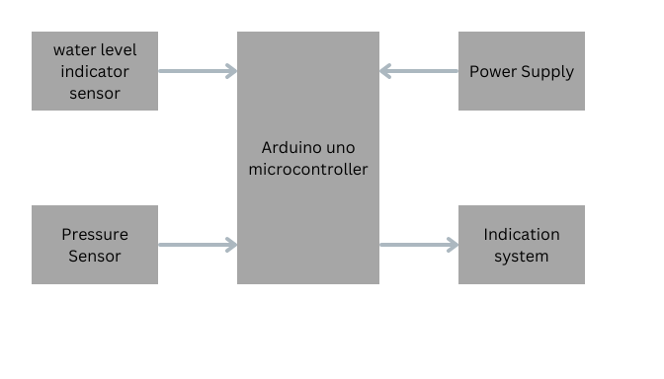
BLOCK DIAGRAM

Slide 8
COST ESTIMATION
s.no | Name of the components | quantity | cost
01 | Arduino UNO | 1 | 650
02 | Water Level sensor | 1 | 150
03 | Pressure sensor | 1 | 100
04 | Water Pump | 1 | 250
05 | LCD Display | 1 | 150
06 | Pipes and Fittings | Few | 500
07 | Others |  | 1000
08 |  | Total | 2650

